Slide 1
Analytics Report
Copyright Removal Requests
By:Tanmay Uttam Sandav

Slide 2
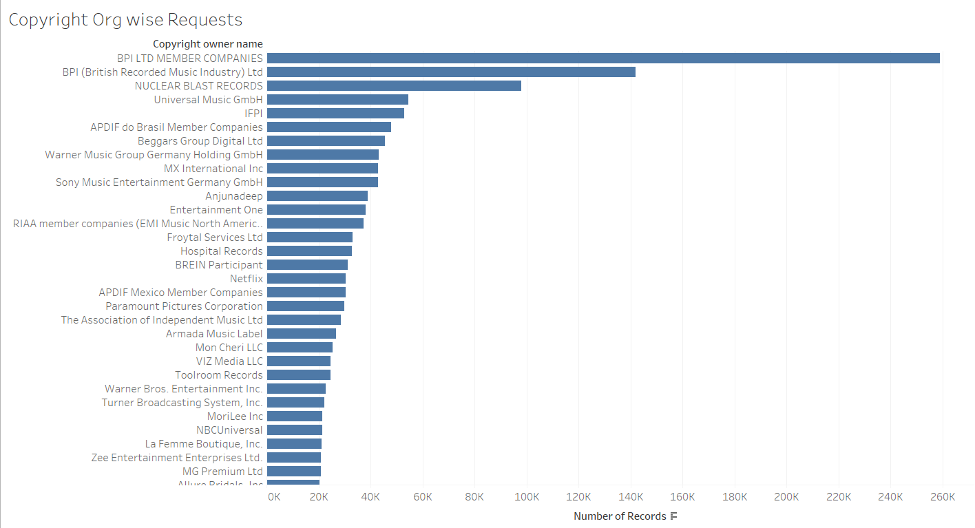
Sum of Requests Copyright owner Wise

Slide 3
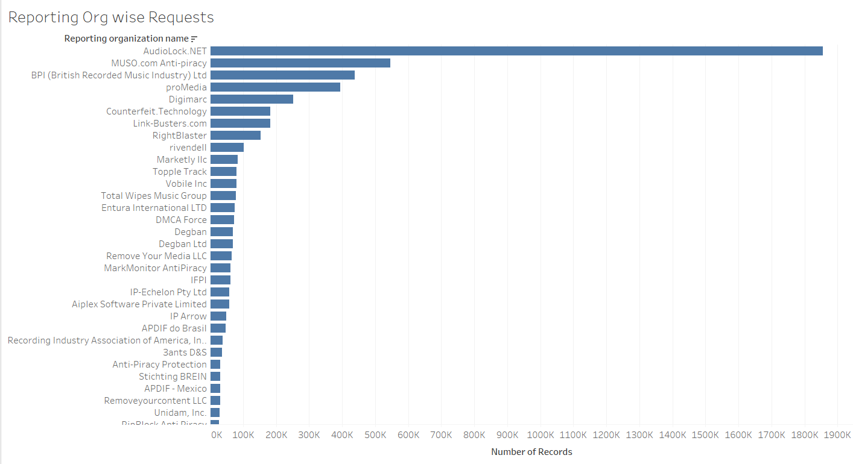
Sum of Requests Reporting ORganization Wise

Slide 4
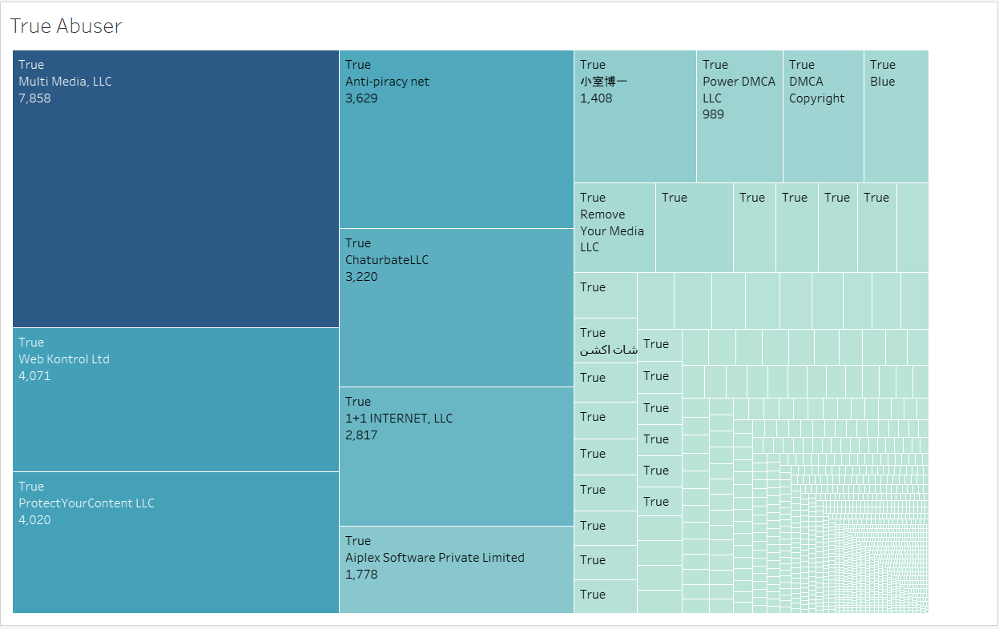
REporting Organizations who are abuser

Slide 5
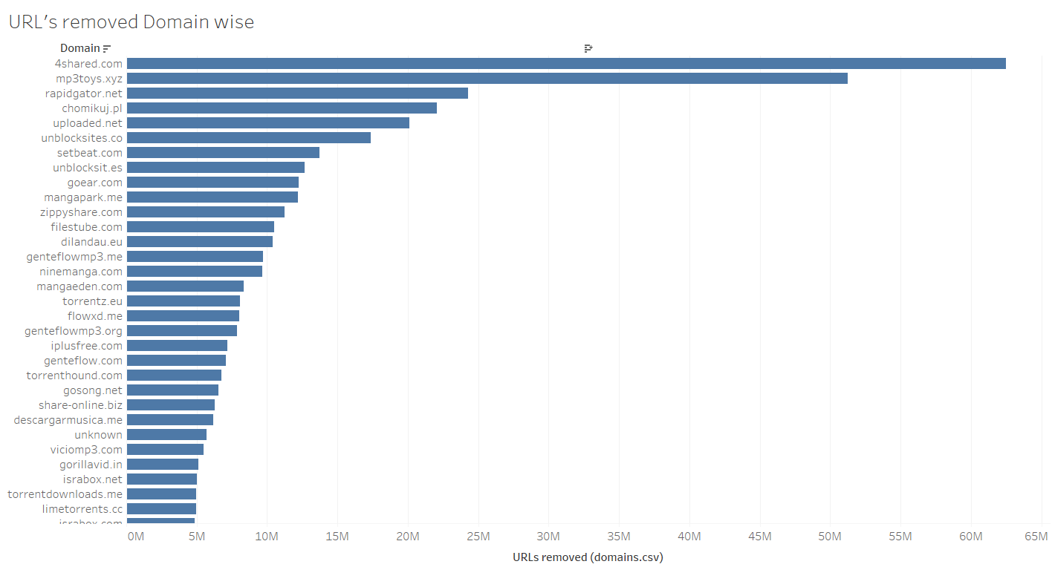
Domains from where URLs Removed

Slide 6
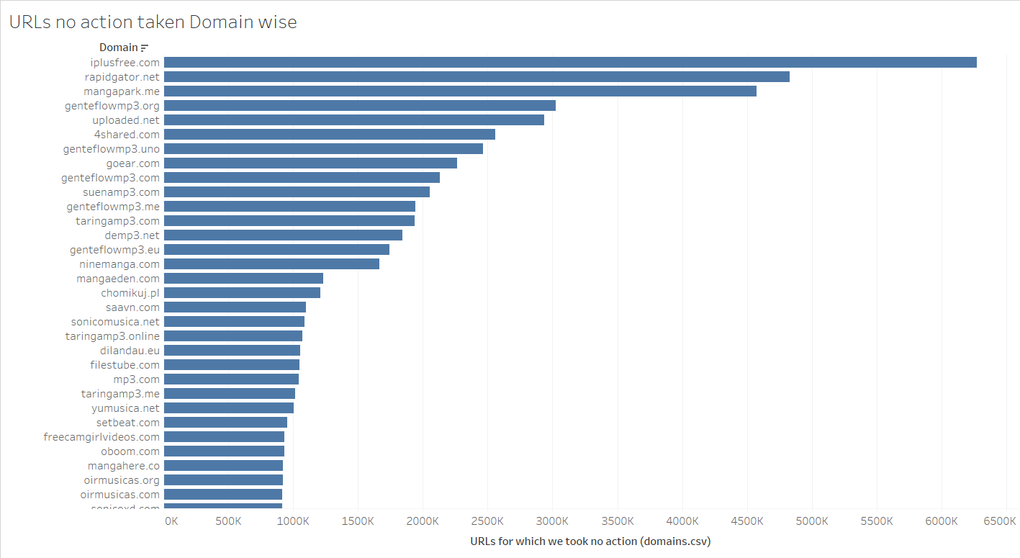
Domains from which no action taken for URL

Slide 7
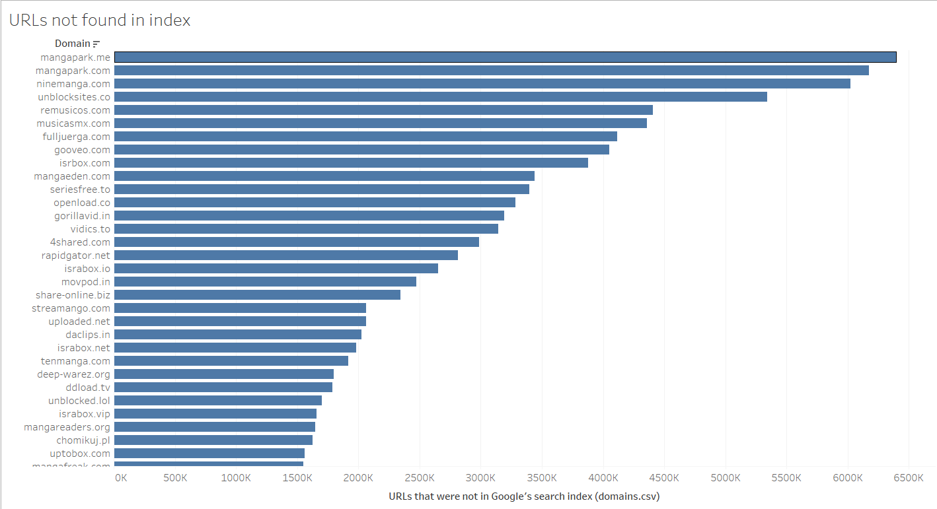
URLs not found in search index Domain wise

